Slide 1
welcome to
COMP 2691
Intermediate Windows Application Development in .NET
Week 2
Input / Output (Part Two)
Amir Ahani, M.Sc. + MBA
Microsoft Certified Solution Developer (MCSD .NET)
Microsoft Certified Database Administrator (MCDBA)
Email: amirahani@gmail.com
<number> of 35
Notes:
COMP2690 Windows Application Development with C#

Slide 2
Today…
Reading and Writing Files
  Understanding Streams
  What Classes Facilitate Reading and Writing Data?
  File – Directory Classes (Utility)
  FileStream Classes
  StreamReader, Stream Writer
  MemoryStream Class
  BufferedStream Class
Lab: Reading and Writing Files
<number> of 35
Notes:
COMP2690 Windows Application Development with C#

Slide 3
Understanding Streams
  Streams are a common way to deal with both sequential and random access to data within the .NET Framework. Streams are used throughout different parts of the Framework. They begin with an abstract class (by means of the MustInherit keyword
  in Visual Basic) that provides the basic interface and implementation for all streams in the Framework.
<number> of 35
Notes:
COMP2690 Windows Application Development with C#

Slide 4
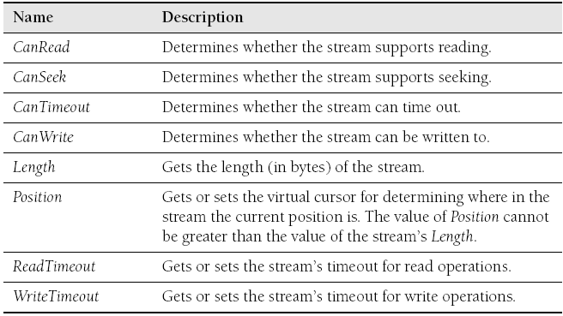
Understanding Streams
  Stream Properties:
<number> of 35
Notes:
COMP2690 Windows Application Development with C#

Slide 5
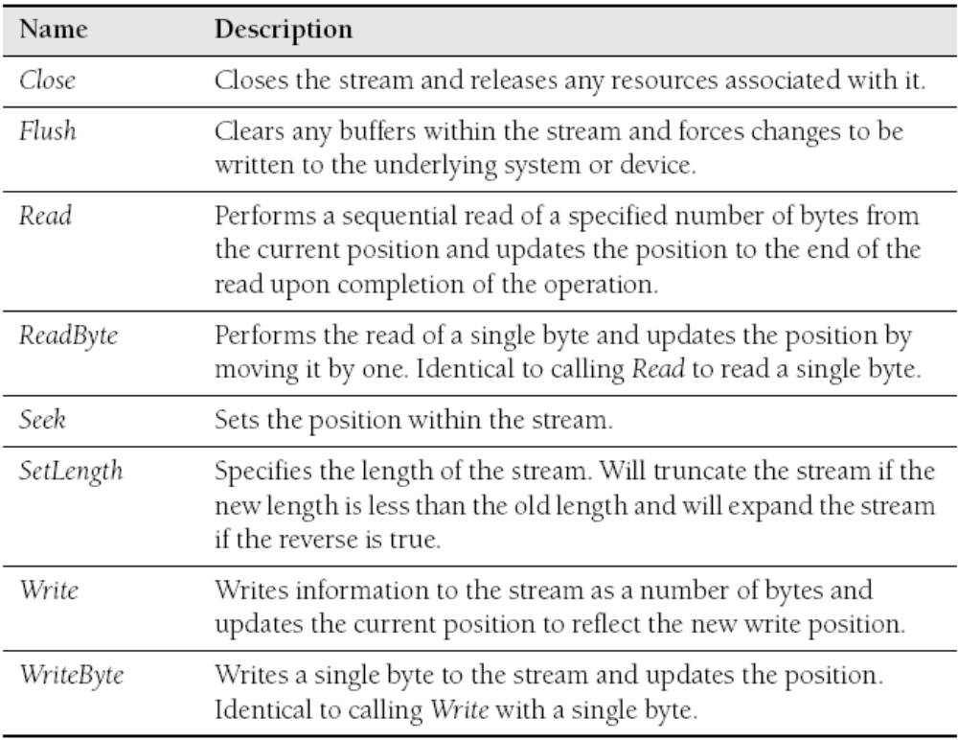
Understanding Streams
  Stream Methods:
<number> of 35
Notes:
COMP2690 Windows Application Development with C#

Slide 6
What Classes Facilitate Reading and Writing Data?
  A number of classes take part in the process of reading and
  writing files. Most operations begin with the File class. This
  class exposes static methods that allow for opening and
  creating files. The File class can perform several types of
  operations:
    Atomic operations to read or write all the contents of a file
    Operations to create or open files for reading
    Operations to create or open files for writing
    Simple file operations (File.Exists, File.Delete, and so on)
<number> of 35
Notes:
COMP2690 Windows Application Development with C#

Slide 7
What Classes Facilitate Reading and Writing Data?
When a file is opened or created, the File class can return several
types of objects. The most rudimentary of these is the FileStream
object. This is a simple stream class, but it represents a file in the
file system.
In addition, the File class also has methods that return
StreamReaders and StreamWriters.
These classes wrap a FileStream to support sequential reading and
writing to a stream.
The simple file operations that the File class supports are identical
to FileInfo class.
In addition to these classes, the MemoryStream class is a
specialized stream for manipulating data in memory. This class is
often used to create stream objects in memory for optimizations.
<number> of 35
Notes:
COMP2690 Windows Application Development with C#

Slide 8
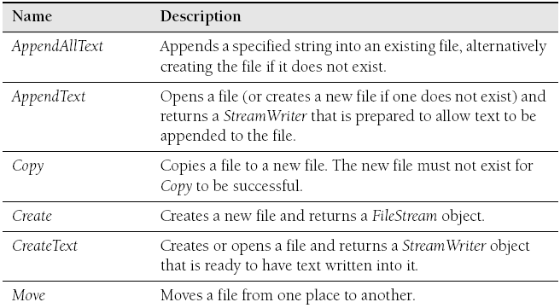
File Class
  The File class provides the basic functionality to open file
  streams for reading and writing
  File Methods:
<number> of 35
Notes:
COMP2690 Windows Application Development with C#

Slide 9
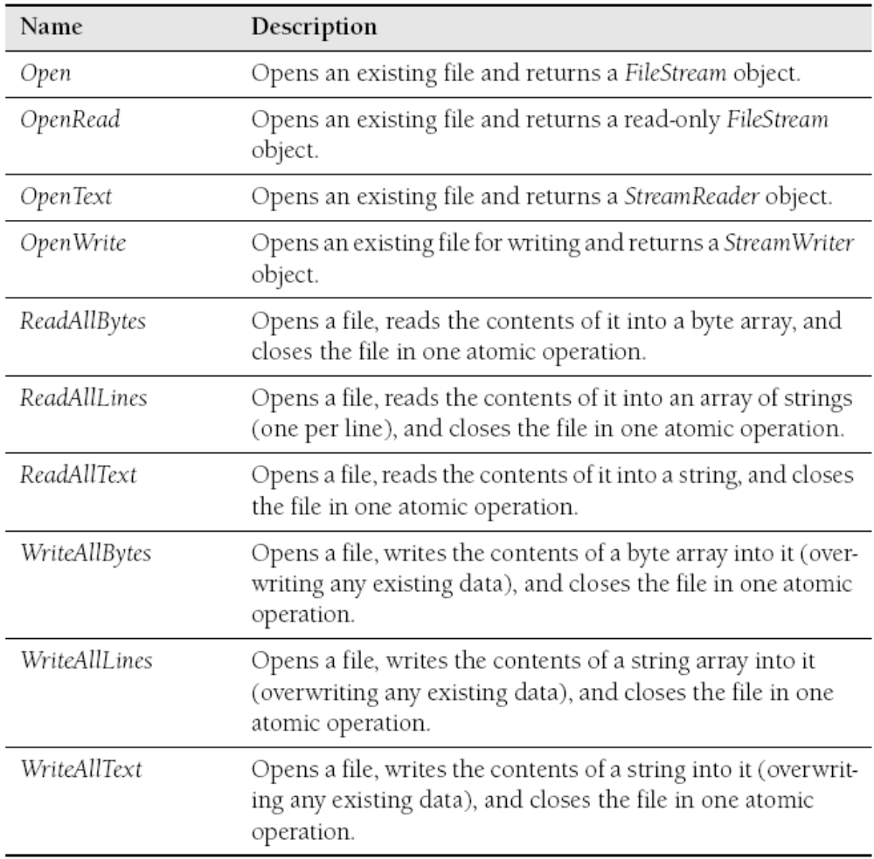
File Class
  File Methods:
<number> of 35
Notes:
COMP2690 Windows Application Development with C#

Slide 10
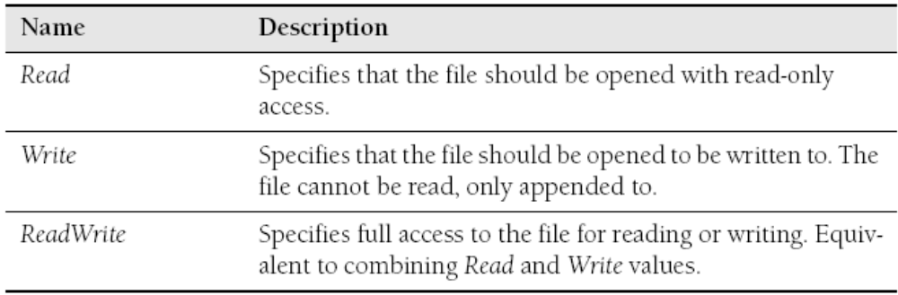
File Class
FileAccess Enumeration
  The FileAccess enumeration provides members that are used to determine the rights required when opening a file.
<number> of 35
Notes:
COMP2690 Windows Application Development with C#

Slide 11
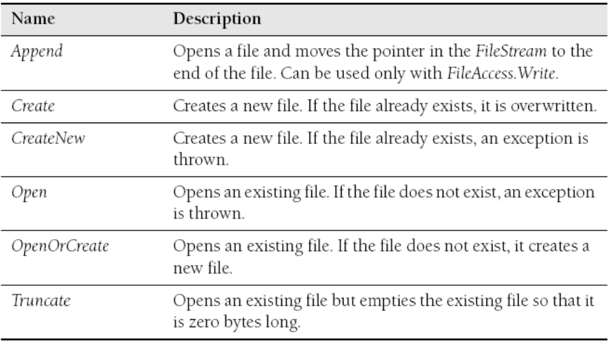
File Class
FileMode Enumeration
  The FileMode enumeration provides members that
  specify how a file is to be opened or created.
<number> of 35
Notes:
COMP2690 Windows Application Development with C#

Slide 12
Directory Class
  .NET Framework supports the Directory class, which presents a static/shared interface for manipulating and creating directories in the file system. The Directory class provides the basic functionality to open file streams for reading and writing.
<number> of 35
Notes:
COMP2690 Windows Application Development with C#

Slide 13
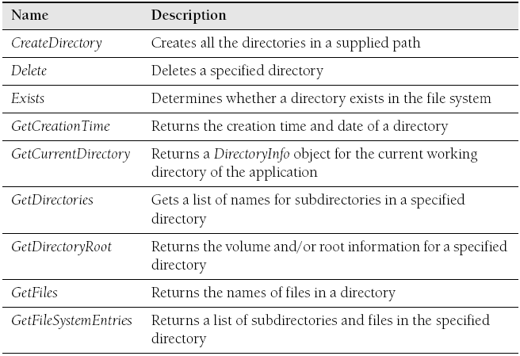
Directory Class
  Directory Methods:
<number> of 35
Notes:
COMP2690 Windows Application Development with C#

Slide 14
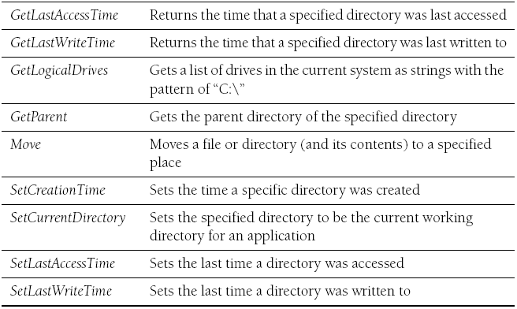
Directory Class
  Directory Methods:
<number> of 35
Notes:
COMP2690 Windows Application Development with C#

Slide 15
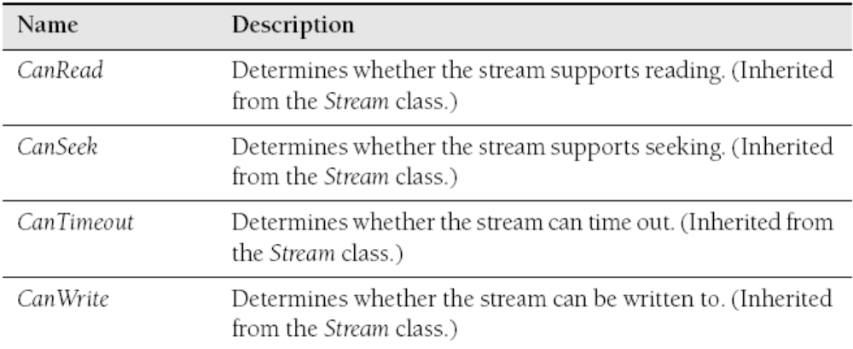
FileStream Class
  The FileStream class provides the basic functionality to open file streams for reading and writing
  FileStream Properties:
<number> of 35
Notes:
COMP2690 Windows Application Development with C#

Slide 16
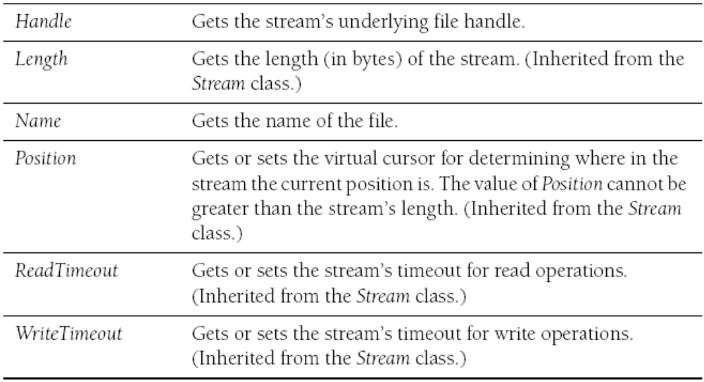
FileStream Class
  FileStream Properties:
<number> of 35
Notes:
COMP2690 Windows Application Development with C#

Slide 17
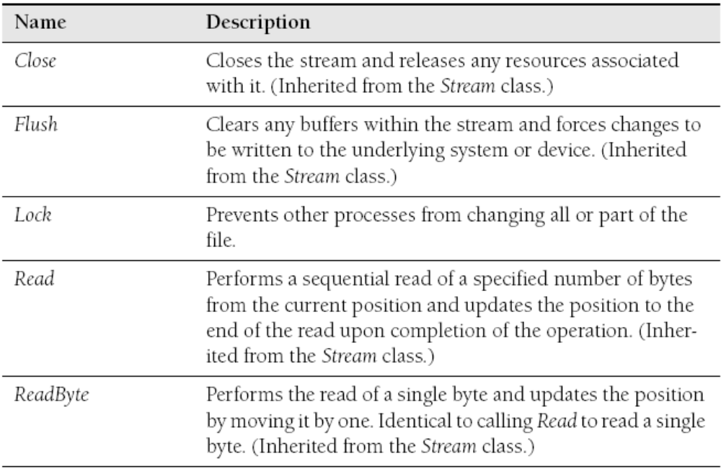
FileStream Class
  FileStream Methods:
<number> of 35
Notes:
COMP2690 Windows Application Development with C#

Slide 18
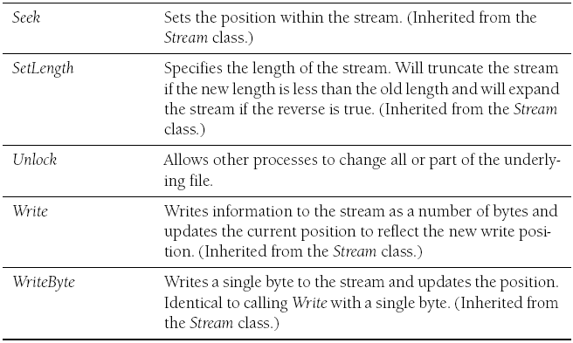
FileStream Class
  FileStream Methods:
<number> of 35
Notes:
COMP2690 Windows Application Development with C#

Slide 19
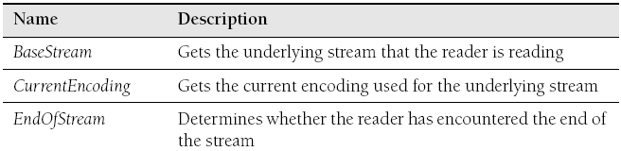
StreamReader Class
StreamReader Class
  The StreamReader class provides the basic functionality to read data from a Stream derived class
  StreamReader Properties:
<number> of 35
Notes:
COMP2690 Windows Application Development with C#

Slide 20
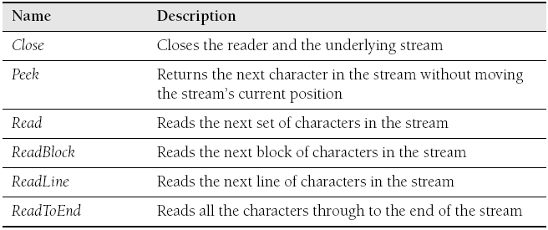
StreamReader Class
  StreamReader Methods:
* Practical Tip:
The Peek method returns an integer value which represents the next character to be read, or -1
if no more characters are available or the stream does not support seeking.
<number> of 35
Notes:
COMP2690 Windows Application Development with C#

Slide 21
StreamReader Class
Example: How to Read from a File
  FileStream theFile = File.Open(@"C:\boot.ini", FileMode.Open,
  FileAccess.Read);
  StreamReader rdr = new StreamReader(theFile);
  Console.Write(rdr.ReadToEnd());
  rdr.Close();
  theFile.Close();
  StreamReader rdr = File.OpenText(@"C:\boot.ini");
  Console.Write(rdr.ReadToEnd());
  rdr.Close();
  Console.WriteLine(File.ReadAllText(@"C:\boot.ini"));
<number> of 35
Notes:
COMP2690 Windows Application Development with C#

Slide 22
StreamReader Class
Example: How to Search inside a File
  StreamReader rdr = File.OpenText(@"C:\boot.ini");
  // Search through the stream until we reach the end
  while (!rdr.EndOfStream)
  {
  string line = rdr.ReadLine();
  if (line.Contains("boot"))
  {
  // If we find the word boot, we notify
  // the user and stop reading the file.
  Console.WriteLine("Found boot:");
  Console.WriteLine(line);
  break;
  }
  }
  // Clean Up
  rdr.Close();
<number> of 35
Notes:
COMP2690 Windows Application Development with C#

Slide 23
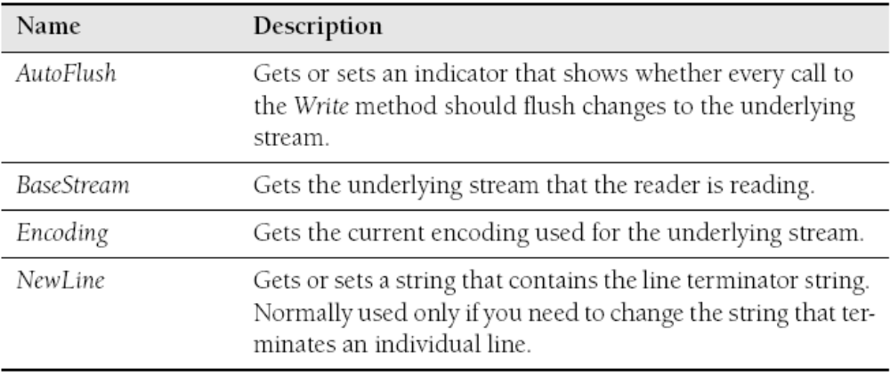
StreamWriter Class
StreamWriter Class
  The StreamWriter class provides the basic functionality to read data from a Stream derived class.
  StreamWriter Properties:
<number> of 35
Notes:
COMP2690 Windows Application Development with C#

Slide 24
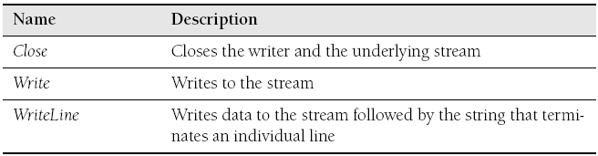
StreamWriter Class
  StreamWriter Methods:
<number> of 35
Notes:
COMP2690 Windows Application Development with C#

Slide 25
StreamWriter Class
Example: How to Write to a File
  FileStream theFile = File.Create(@"c:\somefile.txt");
  StreamWriter writer = new StreamWriter(theFile);
  writer.WriteLine("Hello");
  writer.Close();
  theFile.Close();
  StreamWriter writer = File.CreateText(@"c:\somefile.txt");
  writer.WriteLine("Hello");
  writer.Close();
  File.WriteAllText(@"c:\somefile.txt", "Hello");
<number> of 35
Notes:
COMP2690 Windows Application Development with C#

Slide 26
StreamWriter Class
Example: How to Write to an existing File
  FileStream theFile = null;
  theFile = File.Open(@"c:\somefile.txt", FileMode.Open, FileAccess.Write);
  theFile = File.OpenWrite(@"c:\somefile.txt");
  theFile = File.Open(@"c:\somefile.txt", FileMode.OpenOrCreate,
  FileAccess.Write);
<number> of 35
Notes:
COMP2690 Windows Application Development with C#

Slide 27
Readers and Writers
Understanding Readers and Writers
( StringReader – StringWriter – BinaryReader – BinaryWriter )
  StreamReader and StreamWriter are classes that make it simple to write to and read from text streams. That is the purpose of the reader and writer classes. The StreamReader class derives from the abstract TextReader class. The StreamWriter, not surprisingly, derives from the abstract TextWriter class. These abstract classes represent the basic interface for all text-based readers and writers.
<number> of 35
Notes:
COMP2690 Windows Application Development with C#

Slide 28
Readers and Writers
Understanding Readers and Writers
  There is an additional text reader and writer pair calledStringReader and StringWriter. The purpose of these classes is to write to and read from in-memory strings.
<number> of 35
Notes:
COMP2690 Windows Application Development with C#

Slide 29
Readers and Writers
Example: How to Read an in-memory string using StringReader
  string s = @"Hello all
  This is a multi-line
  text string";
  StringReader rdr = new StringReader(s);
  // See if there are more characters
  while (rdr.Peek() != -1)
  {
  string line = rdr.ReadLine();
  Console.WriteLine(line);
  }
<number> of 35
Notes:
COMP2690 Windows Application Development with C#

Slide 30
Readers and Writers
Example: How to Write an in-memory string using StringWriter
  StringWriter writer = new StringWriter();
  writer.WriteLine("Hello all");
  writer.WriteLine("This is a multi-line");
  writer.WriteLine("text string");
  Console.WriteLine(writer.ToString());
<number> of 35
Notes:
COMP2690 Windows Application Development with C#

Slide 31
BinaryReader/BinaryWriter Classes
BinaryReader - BinaryWriter Classes
  .NET Framework namespace also supports two classes for writing binary data. The BinaryReader and BinaryWriter classes can be used to handle getting binary data to and from streams.
<number> of 35
Notes:
COMP2690 Windows Application Development with C#

Slide 32
MemoryStream Class
MemoryStream Class
  The MemoryStream class provides the basic functionality to create in-memory streams. As you have seen, working with streams of data is an important skill for any developer. Unfortunately, often you will need to create a stream before you really need to store it somewhere. The MemoryStream class has the job of helping you create streams in memory.
<number> of 35
Notes:
COMP2690 Windows Application Development with C#

Slide 33
MemoryStream Class
Example: How to Use a MemoryStream
  MemoryStream memStrm = new MemoryStream();
  StreamWriter writer = new StreamWriter(memStrm);
  writer.WriteLine("Hello");
  writer.WriteLine("Goodbye");
<number> of 35
Notes:
COMP2690 Windows Application Development with C#

Slide 34
Example
Reading and Writing Files
class Program
{
static void Main(string[] args)
{
StreamWriter writer = File.CreateText(@"c:\newfile.txt");
writer.WriteLine("This is my new file");
writer.WriteLine("Do you like its format?");
writer.Close();
}
}
<number> of 35
Notes:
COMP2690 Windows Application Development with C#

Slide 35
Summary
  The File class can be used to open files, create new
  files, read whole files atomically, and even write files.
  The FileStream class represents a file in the file system
  and allows for reading and writing (depending on how it
  is created).
  The StreamReader and StreamWriter classes are used
  to simplify the writing of strings to streams.
  The MemoryStream is a specialized stream for creating
  content in memory and supports saving the stream to
  other streams.
<number> of 35
Notes:
COMP2690 Windows Application Development with C#

